Slide 1
Revised Total Coliform Rule
Elements of Level 1 & Level 2 Assessment Plans

Slide 2
NYRWA Annual Conference, Verona, NY – May 19, 2015

Slide 3
Agenda
Rule Implementation
Overview of Revised Total Coliform Rule Key Provisions
Level 1 Assessment Elements
Level 2 Assessment Elements
Sample Siting Plans

Slide 4
Revised Total Coliform Rule – Brief History
Current Total Coliform Rule – 1989
SDWA requires EPA to review/revise, each National Primary Drinking Water Regulation no less often than every six years; In 2003, EPA reviewed and decided to revise the TCR
Advisory Committee – formed July 2007
Agreement in Principle – September 2008
Proposed Rule – July 2010
Final Rule – promulgated February 13, 2013
Minor Corrections – February 26, 2014

Slide 5
New York State Implementation
Effective Date – April 1, 2016
Concept Memo presented to DOH Regulatory Advisory Committee
Stakeholder Workgroup Formed
Stakeholder outreach (Total of seven presentations planned so far for 2015)
Promulgation into NYS Sanitary code – extension request to EPA
Notes:
Some of the documents that we are developing: Level 1/Level 2 Assessment Forms, Total Coliform Sample Siting Plan Template, Start Up Procedures for Seasonal Systems

Slide 6
RTCR – Key Monitoring Provisions
Maintains routine sampling structure of 1989 TCR
Allows systems to transition on existing TCR schedule
Reduces follow-up samples (repeat/additional routine) for systems ≤1,000
Reduced monitoring available for systems ≤1,000
Provides more stringent criteria for systems to qualify and remain on reduced monitoring
Requires small systems with problems to monitor more frequently

Slide 7
RTCR – Key Assessments and Corrective Action Provisions
Requires PWSs to investigate their system and correct sanitary defects found when monitoring results show the PWS may be vulnerable to contamination
PWSs must conduct a basic self assessment (Level 1) or a more detailed assessment by LHD (Level 2) depending on severity/frequency of contamination
Failure to assess and correct is a Treatment Technique (TT) violation

Slide 8
Assessments
Conducted in order to identify the possible presence of sanitary defects and defects in distribution system coliform monitoring practices
Find and Fix
Minimum elements: sample sites, sampling protocol, sample processing, atypical events, distribution system operation/maintenance, source, treatment, storage, water quality

Slide 9
Notes:
Level 2 numbers only include MCL violations, not two level 1 assessments in 12 month period, next slide has that estimate

Slide 10
Assessment Data
Average over 15 years – Level 1 = 161, Level 2 = 62
Average over the past 5 years – Level 1 = 121, Level 2 = 40
MCLs trending downward
2014: 108 TC MCLs (Level 1), 34 E. coli MCLs (Level 2)
Two TC MCLs within a 12 month period (2013-2014) = 28 at 19 systems

Slide 11
Sanitary Defect
A defect that could provide a pathway of entry into the distribution system or that is indicative of a failure or imminent failure in a barrier that is already in place
Must be corrected if found during an assessment
Notify public within 30 days if system does not investigate or fix an identified problem

Slide 12
Level 1 Assessment Elements

Slide 13
Level 1 Assessment
Replaces TC MCL
Systems collecting ≥ 40 samples per month, > 5.0% are total coliform positive
Systems collecting < 40 samples per month, two or more are total coliform positive
System fails to take every required repeat sample after any single total coliform positive sample

Slide 14
Level 1 Assessment
Copy (Arial Regular)

Slide 15
Level 1 Assessments
Self assessment by the PWS
One page form
Questions: interruptions, sample site, sampling protocol, distribution system, storage tank, treatment, source
Must be completed and submitted to the LHD within 30 days of triggered event
Any defects noted must be addressed
Any corrective actions must be included
Notes:
Elements in Level 2 assessment that will be reviewed in upcoming slides are applicable to self assessment Level 1 assessment

Slide 16
General Progression of Assessment
Location of the positive sample(s)
Distribution area near positive sample(s)
Treatment Facilities
Source Water

Slide 17
Level 2 Assessment Elements

Slide 18
Level 2 Assessment
E. coli MCL violation
Failure to collect repeat samples following an E. coli positive routine sample
Second Level 1 trigger within a rolling 12-month period, unless:
  State has determined a likely reason that the initial samples were TC positive, and
  System has corrected the problem

Slide 19
Slide Heading – Arial Bold
Copy (Arial Regular)

Slide 20
Level 2 Assessment
Completed by the State/LHD
More in depth review than Level 1 – similar to sanitary survey
Same elements as Level 1 but in much greater detail
Must be completed within 30 days of trigger
Any sanitary defects identified must be addressed
The following list of questions will be part of the Level 2 Assessment

Slide 21
Level 2 Assessment Questions
1. Have any of the following occurred prior to collection of TC samples?
Were there any operation and maintenance activities that could have introduced total coliforms?
Have there been any interruptions in the treatment process?
Has the system lost pressure to less than 5 psi?
Have there been any vandalism and/or unauthorized access to facilities?
Any visible indicators of unsanitary conditions?

Slide 22
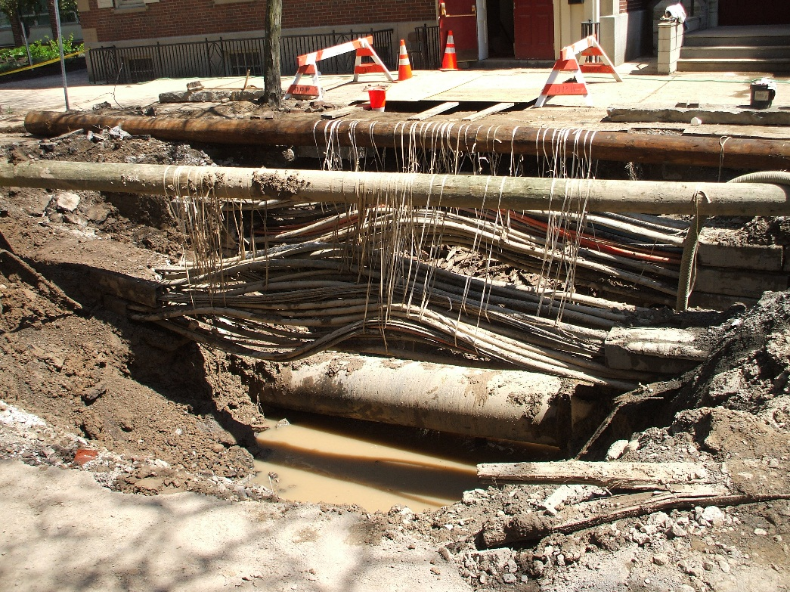
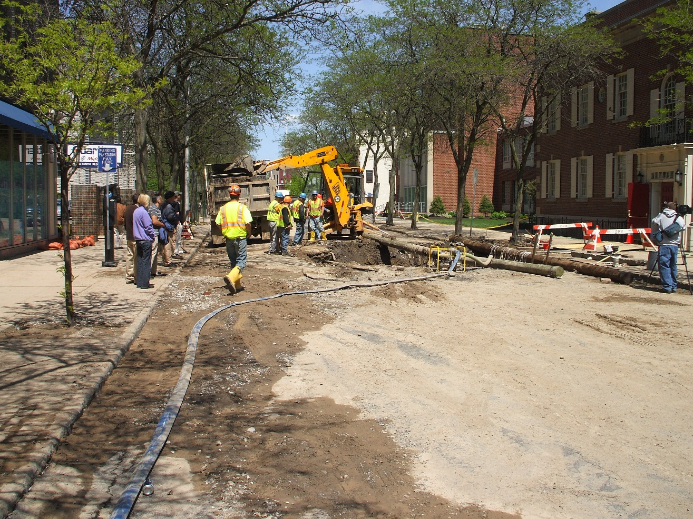
Water main breaks
Notes:
Pictures of 24” water main break – downtown Syracuse 2009

Slide 23
Level 2 Assessment Questions
1. Have any of the following occurred prior to collection of TC samples?
Any additional TC samples (not for compliance) positive?
Any community illness suspected of being waterborne?
Did the system receive any TC monitoring violations in the past 12 months?
Fire fighting event, flushing operation, sheared hydrant, etc.?

Slide 24
Level 2 Assessment Questions
2. Have there been any recent treatment or operational changes?
Have any inactive sources recently been introduced into the system?
Have there been any new sources introduced into the system?
Is there evidence of any potential sources of contamination (Main breaks, low pressure, high turbidity, loss of disinfection, etc.)
Notes:
Walkerton – loss of residual, they should have seen if they were paying attention

Slide 25
Level 2 Assessment Questions
3. Evaluate the sample site
Condition of the tap?
Location of the tap?
Regular use of the connection?
Any plumbing changes or construction?
Plumbing breaks or failure?
Any identified cross connections after the service connection or in premise plumbing?

Slide 26
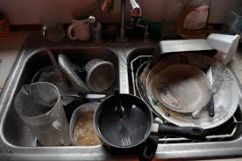
Sample Site Questionable?

Slide 27
Level 2 Assessment Questions
3. Evaluate the sample site
Backflow prevention devices present, operational and maintained?
Low pressure events or changes in water pressure after the service connection or in premise plumbing?
Any treatment devices after the service connection or in premise?

Slide 28
Level 2 Assessment Questions
4. Sample protocol followed and reviewed
Flush Tap
Remove aerator
No swivel
Disinfect
Fresh sample bottles
Sample storage acceptable
Don’t touch inside of cap or set down
New operator collecting sample?

Slide 29
Level 2 Assessment Questions
Never touch the inside of a cap!
Never put the cap down!!
Notes:
Incorrect sampling procedures

Slide 30
Level 2 Assessment Questions
5. Distribution System
Evidence the system experienced low/negative pressure?
Any identified cross connections?
Any sanitary defects in pump station?
Air relief vault subject to flooding?
Fire hydrant/blow off located in high water table?
Distribution system secured to prevent unauthorized access?

Slide 31
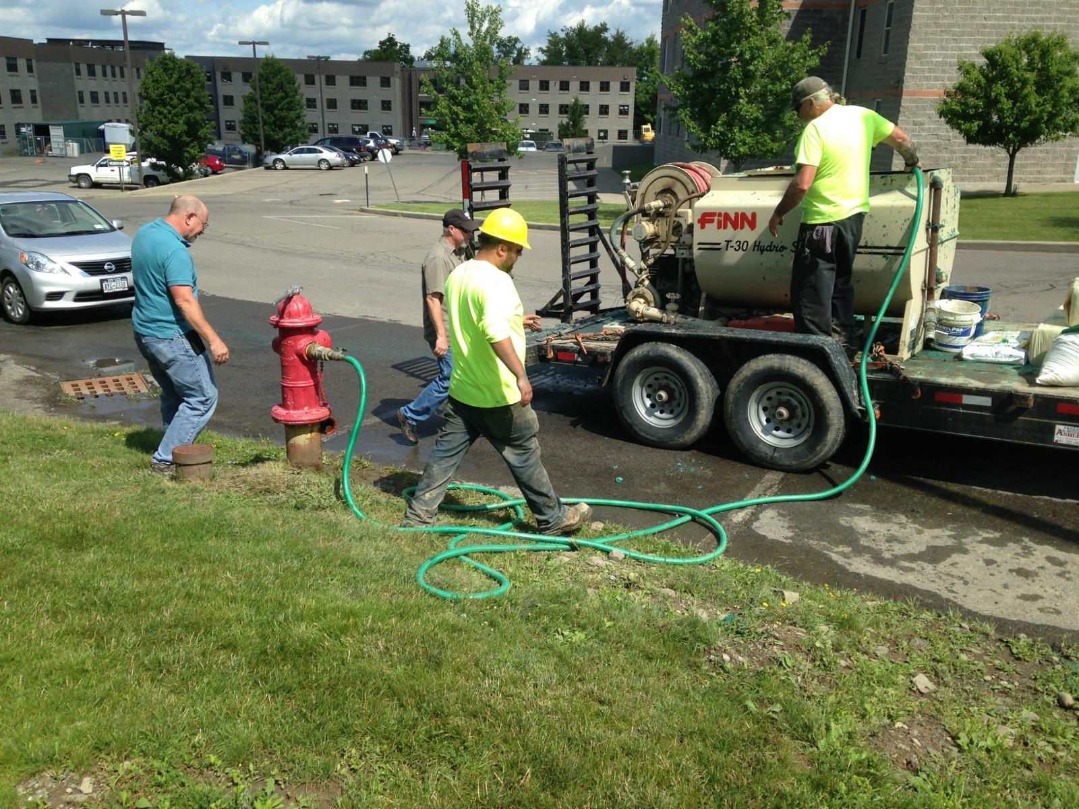
Cross Connection?
Notes:
Hydroseeder hooked up to a hydrant with no backflow prevention – on a college campus

Slide 32
Level 2 Assessment Questions
5. Distribution System
Backflow prevention devices at high risk sites present, operational and maintained?
Water main repairs or additions?
Water main breaks?
Scheduled flushing of the distribution system?
Evidence of intentional contamination in distribution system?

Slide 33
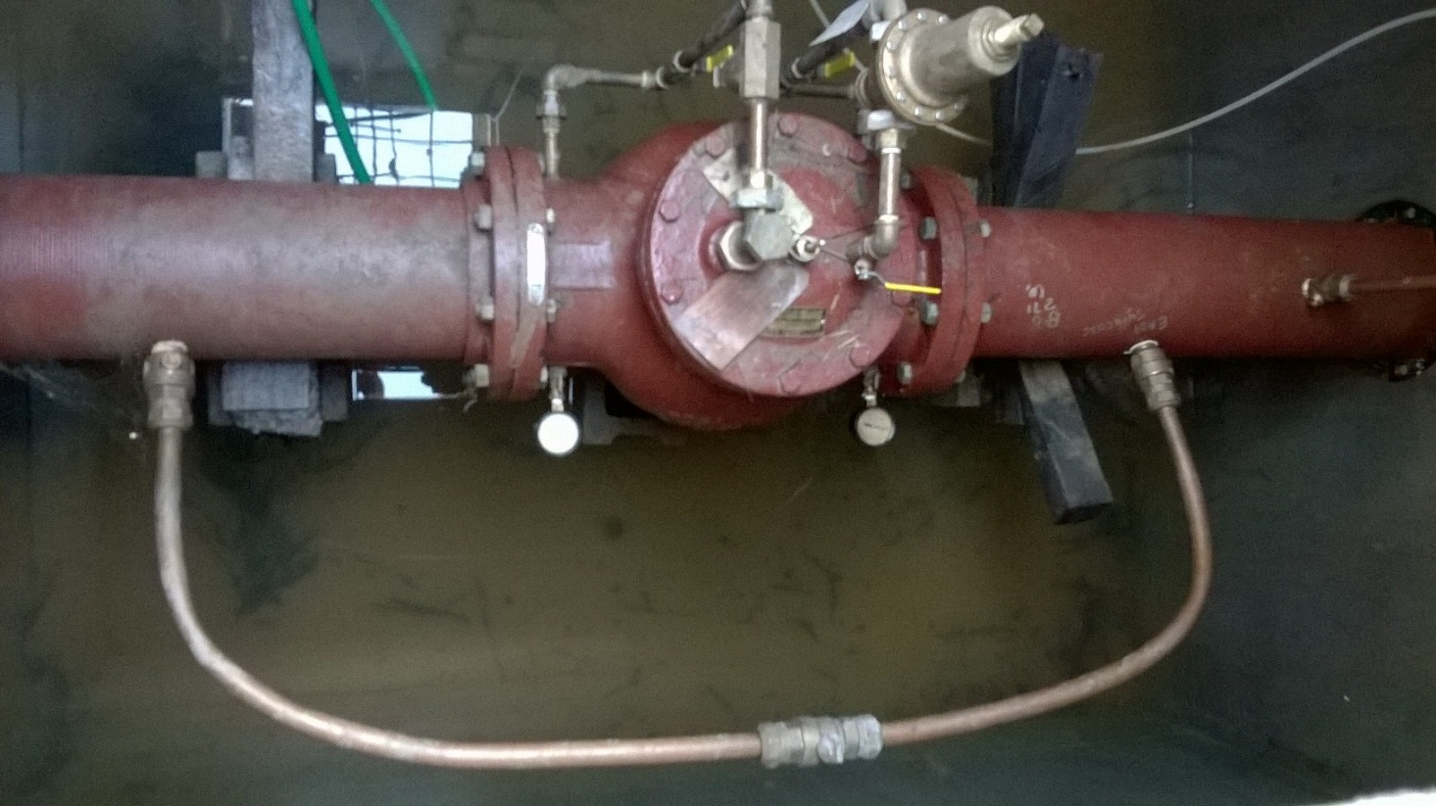
Potential Problem?
Notes:
Pressure reducing valve vault that is flooded – no drain

Slide 34
Level 2 Assessment Questions
6. Storage Facilities
Overflow and vents properly screened?
Facility secured to prevent unauthorized access?
Access opening have the proper gasket and seal?
Physical condition of tank = source of contamination?
Vent turned down and maintain an approved air gap at the termination point?
Notes:
Storage Tank inspections became a focus after the Alamosa, CO outbreak of salmonella due to a storage tank with holes and bird poop, March 2008 – 1 death, 1300 sick, system had a disinfection waiver

Slide 35
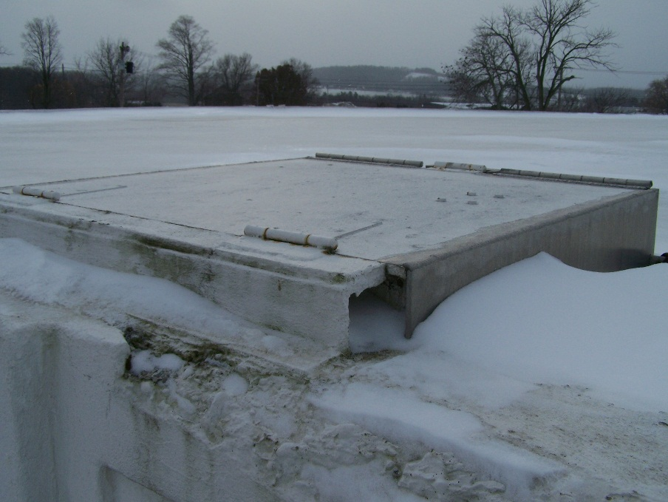
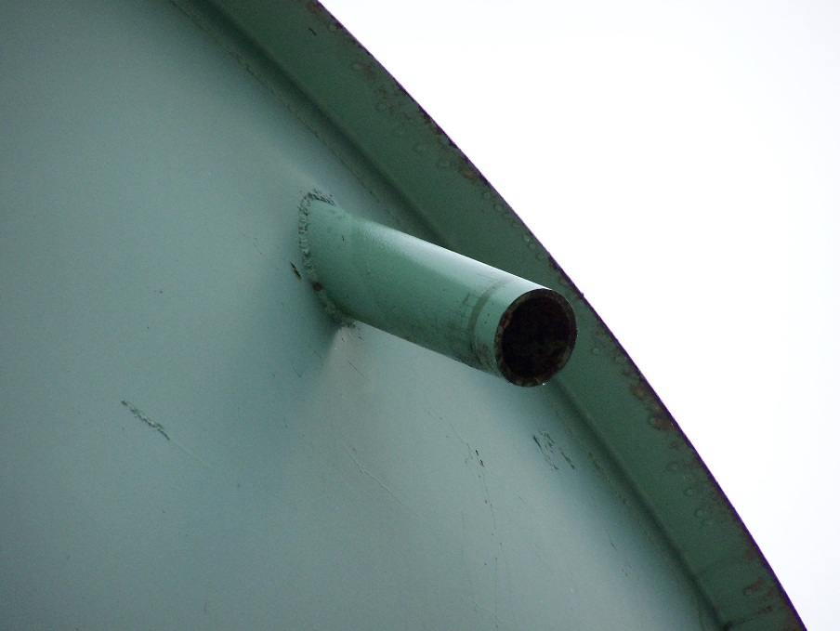
Storage Tank Deficiencies
Notes:
Picture 1: Break in access hatch on concrete ground storage tank
Picture 2: missing screen on tank overflow

Slide 36
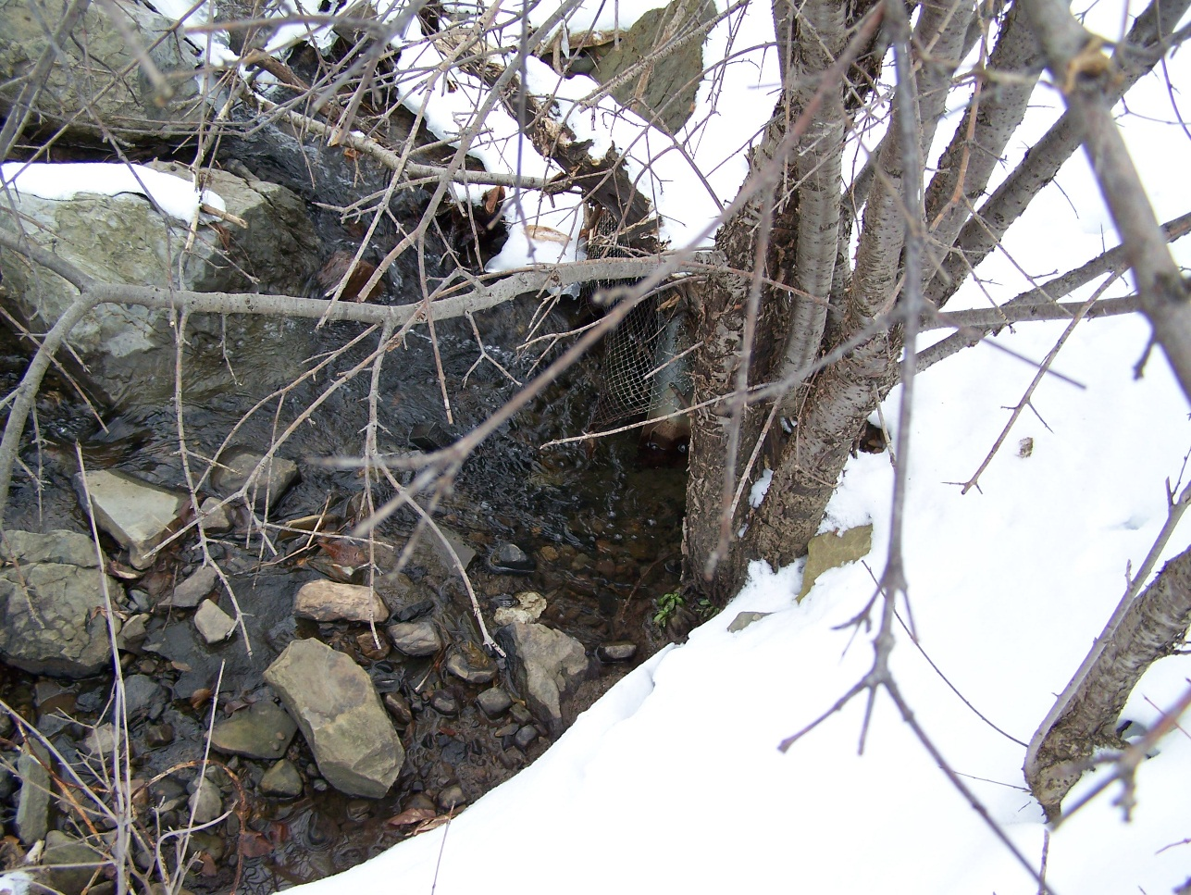
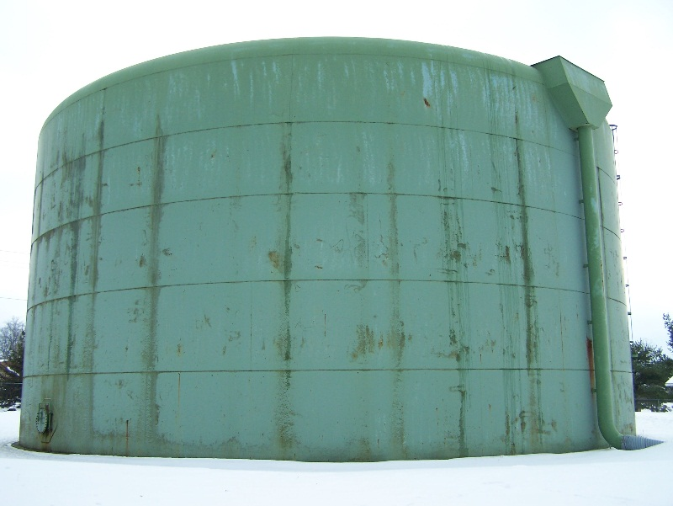
Storage Tank Deficiencies
Notes:
Picture 1: Overflow pipe discharge, screen not secure
Picture 2: Overflow pipe going underground

Slide 37
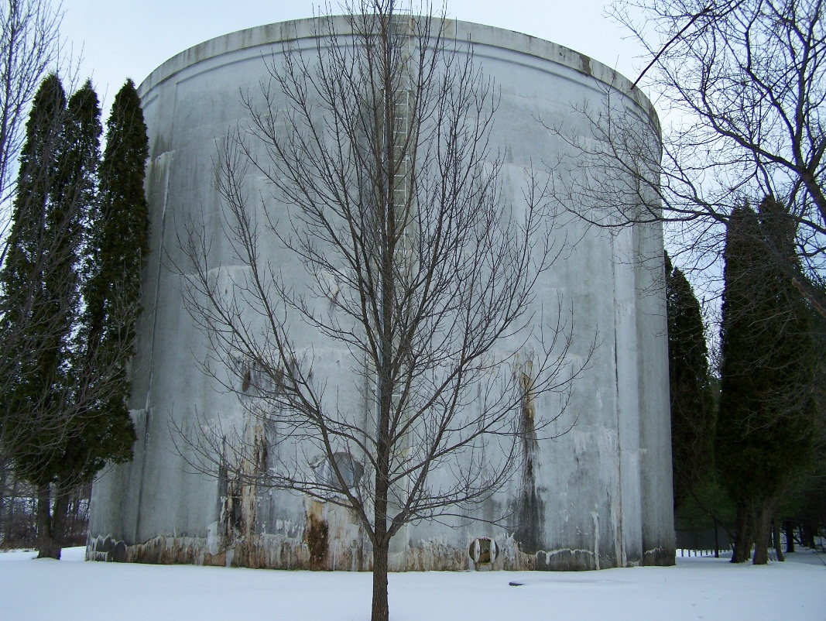
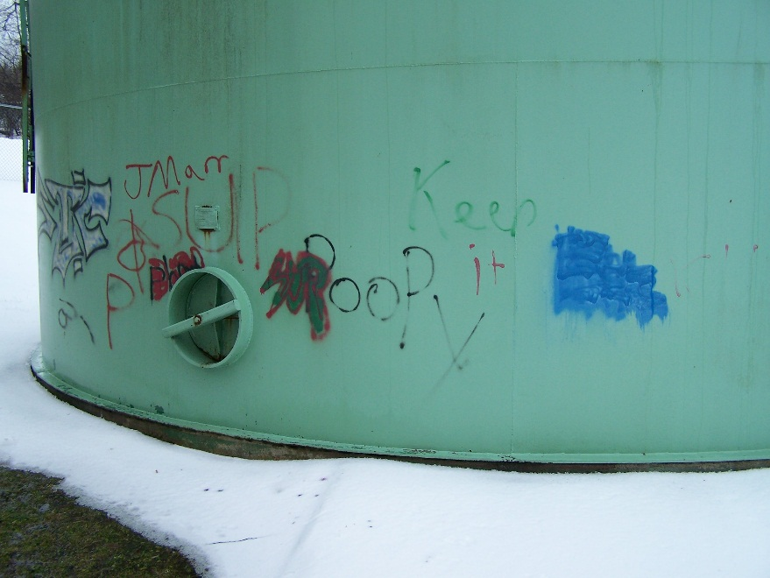
Storage Tank Deficiencies
Notes:
Picture 1: Deteriorated concrete tank – small leaks developing – physical condition of tank could lead to source of contamination?
Picture 2: Spray painted tank – security issue, unauthorized access

Slide 38
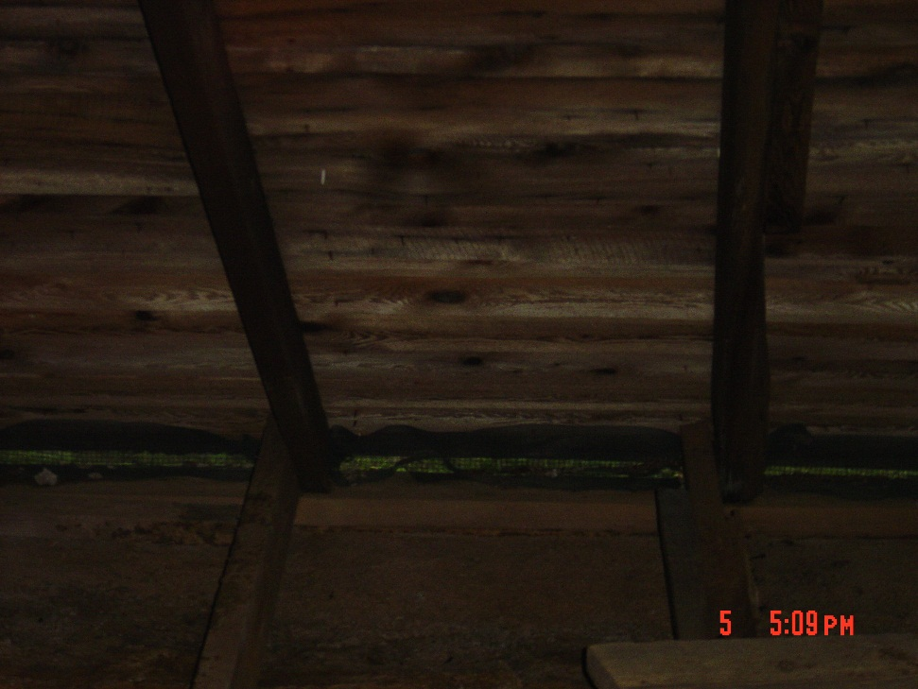
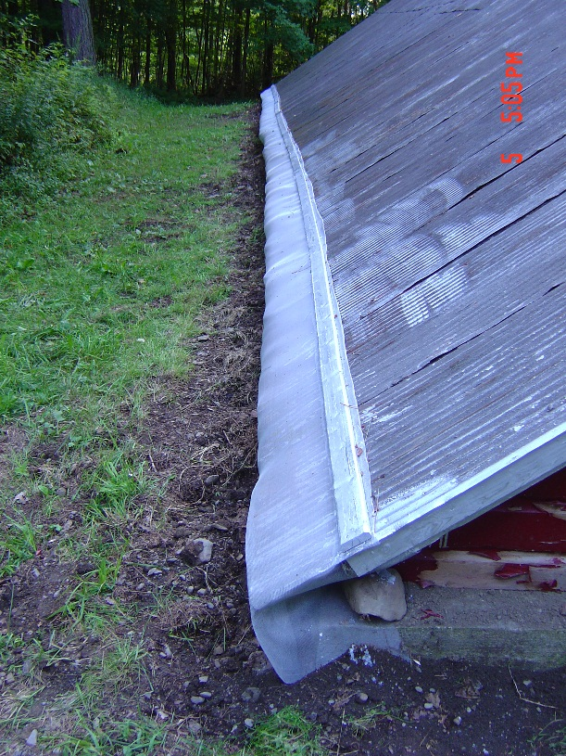
New Screening on a finished water reservoir
Notes:
New screening on reservoir following sanitary survey to keep out groundhogs

Slide 39
Reasons to screen your tank
Notes:
Dead squirrel at bottom of tank
Dead snake at bottom of tank

Slide 40
Level 2 Assessment Questions
6. Storage Facilities
Pressure tank maintaining appropriate minimum pressure
Proper O&M being performed?
Observed physical deterioration of the tank?
Observed leaks?
Evidence of intentional contamination at the storage tank?
Facility maintenance (painting/coating)?
Chlorine Residual?

Slide 41
Level 2 Assessment Questions
7. Treatment Process
Treatment devices operational and maintained?
Any recent installation or repair of treatment equipment?
Recent changes in the treatment process?
Interruptions of treatment? (lapses in chemical feed, turbidity excursions, disinfection, etc.)
Free chlorine residual immediately downstream of injection?

Slide 42
Level 2 Assessment Questions
7. Treatment Process
Review of the filter turbidity profiles reveal any anomalies?
Any failures to meet CT requirements?
Flow rates above rated capacity?
Anomalies on settled water turbidity?
Notes:
Turbidity spikes at certain times?
Not meeting minimum chlorine residual at entry point?
Exceeding flow rate of filters?

Slide 43
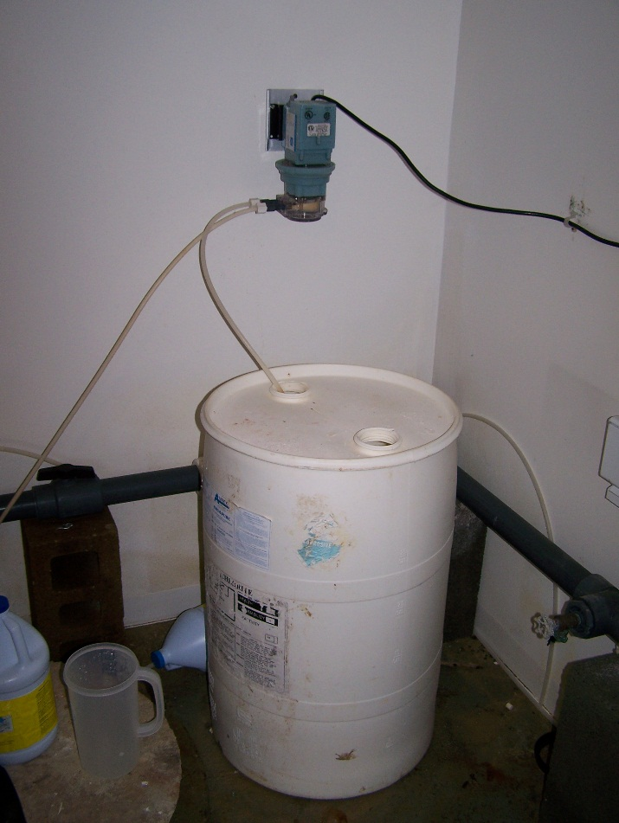
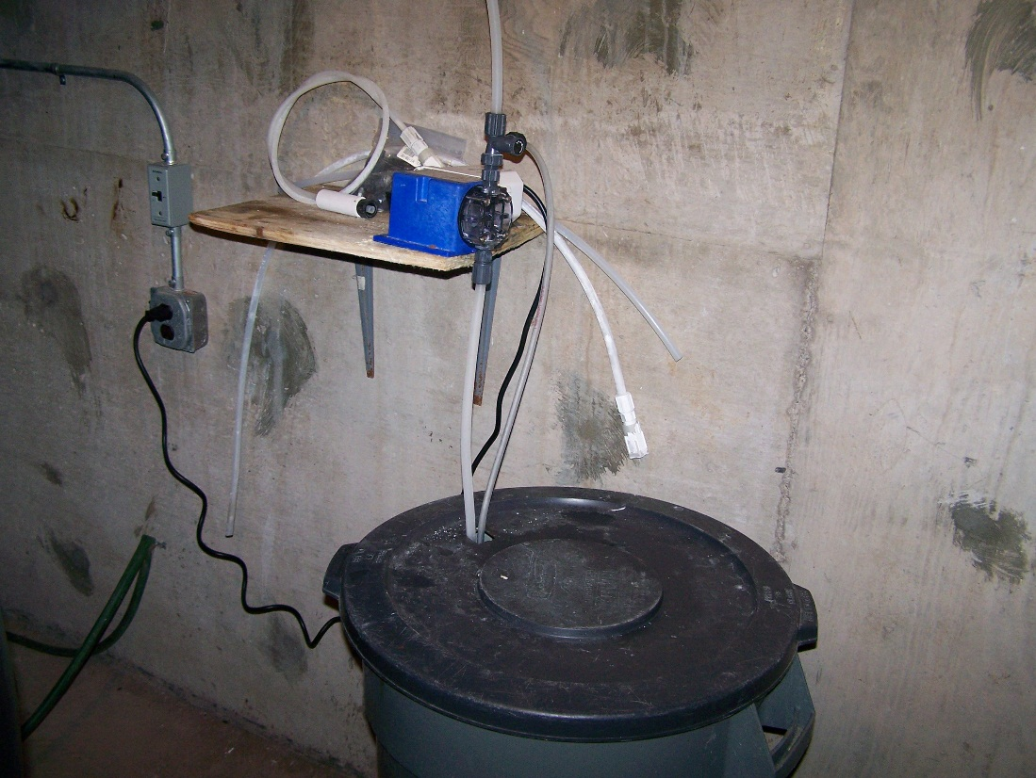
Treatment Issues – What’s the problem?
Notes:
Picture 1 – holes on chlorine container are not screened, may allow contaminants and/or vermin into the chlorine
Picture 2 – not FDA approved container, holes for tubes not screened/too large to let contaminants in

Slide 44
Level 2 Assessment Questions
8. Source – Well
Is the sanitary seal intact?
Is the vent screened?
Vent and pump to waste terminate in an approved air gap?
Any unprotected cross connections at the well head?
Casing above grade?

Slide 45
Level 2 Assessment Questions
8. Source – Well
Well cap vented?
Evidence of standing water near the well head?
Well head secured to prevent unauthorized access?
Any sewer spills, source water spills or other disturbances?

Slide 46
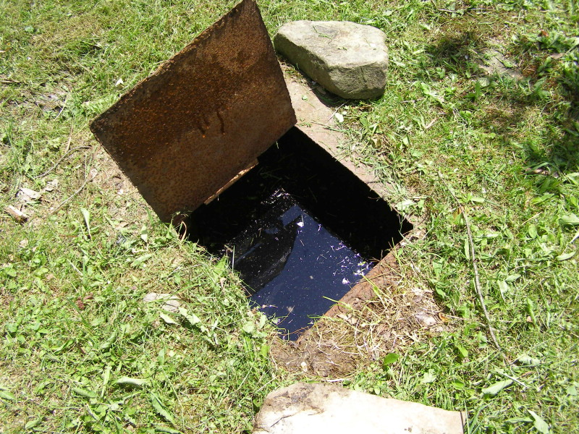
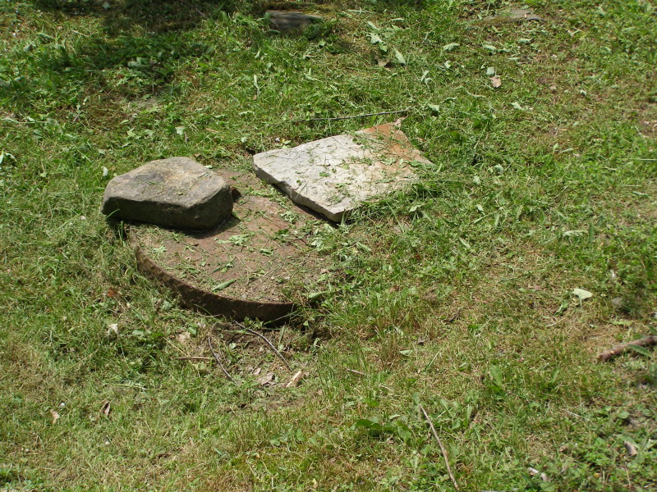
What sanitary seal?

Slide 47
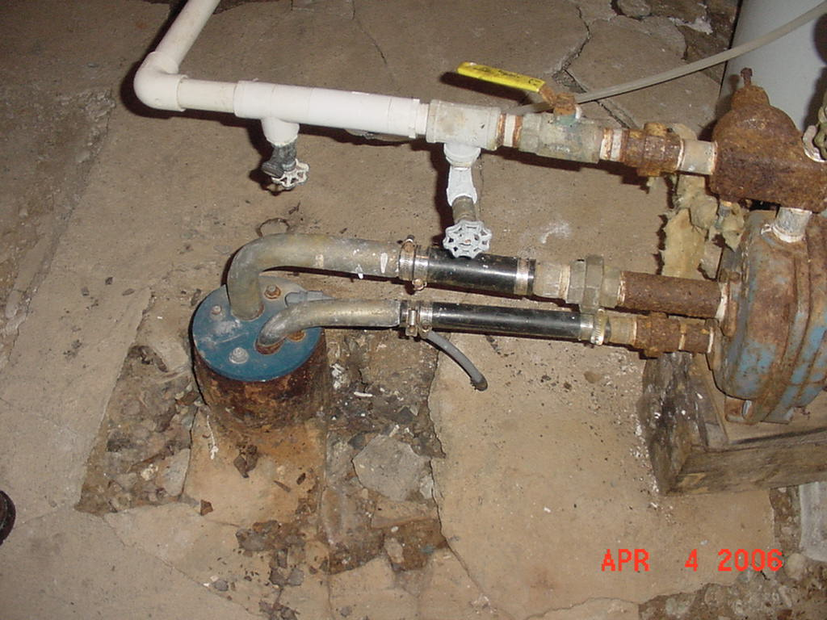
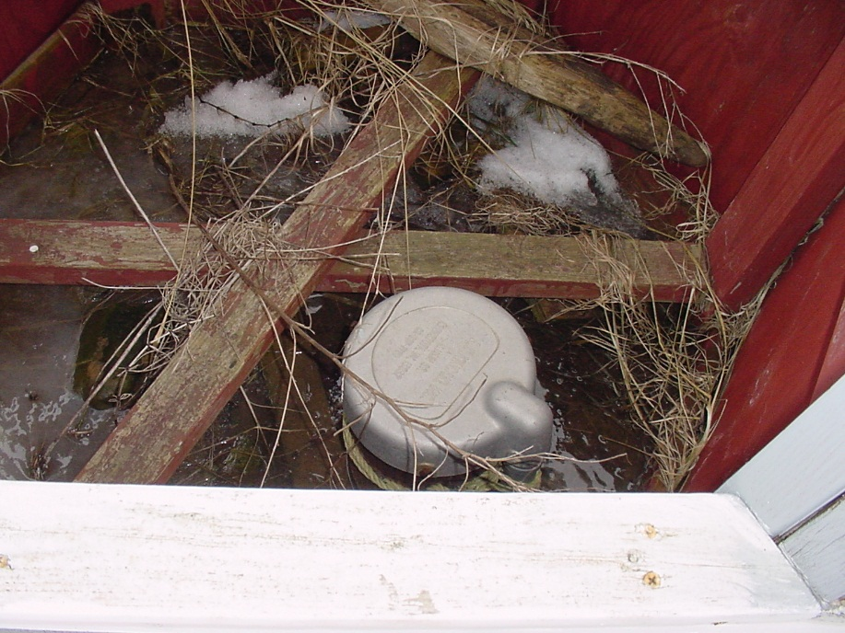
How many sanitary defects do you see?
Notes:
Picture 1 – not 12” above floor, sanitary seal? Venting? Casing intact?
Picture 2 – water around the casing, not 12” above grade, not proper cap, no sanitary seal

Slide 48
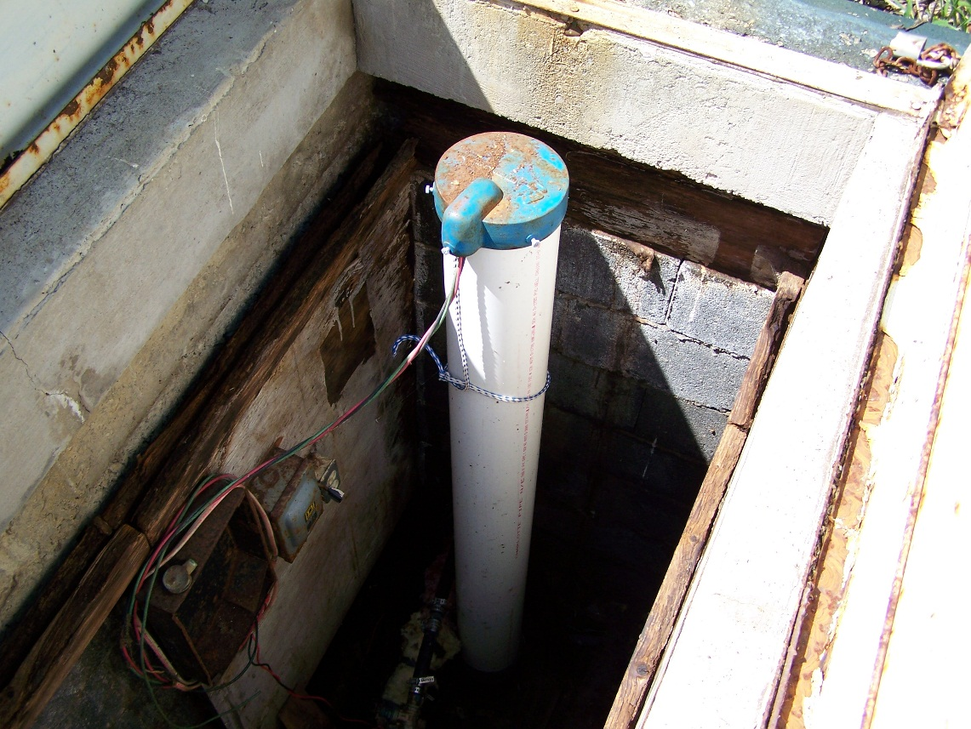
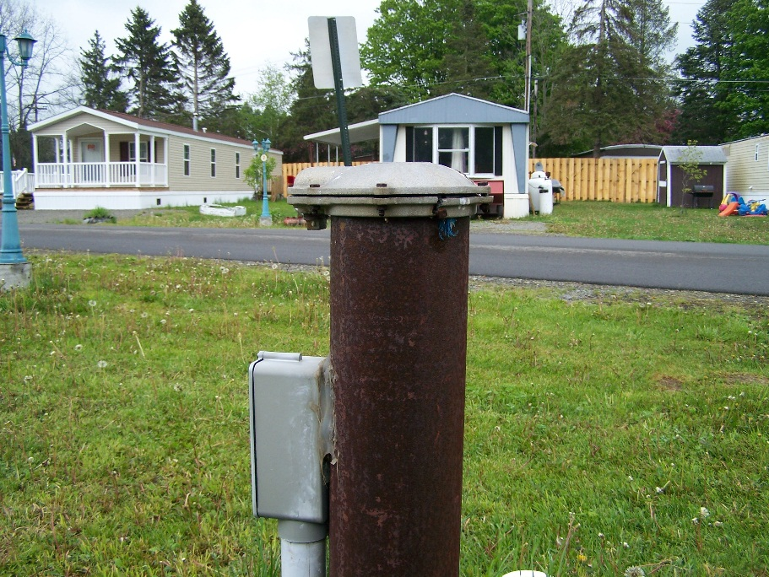
How many sanitary defects do you see?
Notes:
Picture 1 –sanitary seal? Venting? In a vault subject to flooding – maybe mention the exposed electrical wires as a safety hazard (not water issue) – having a good working relationship with the health department they can write up to get leverage with village/city board
Picture 2 – cap is cracked potentially allowing contamination to enter

Slide 49
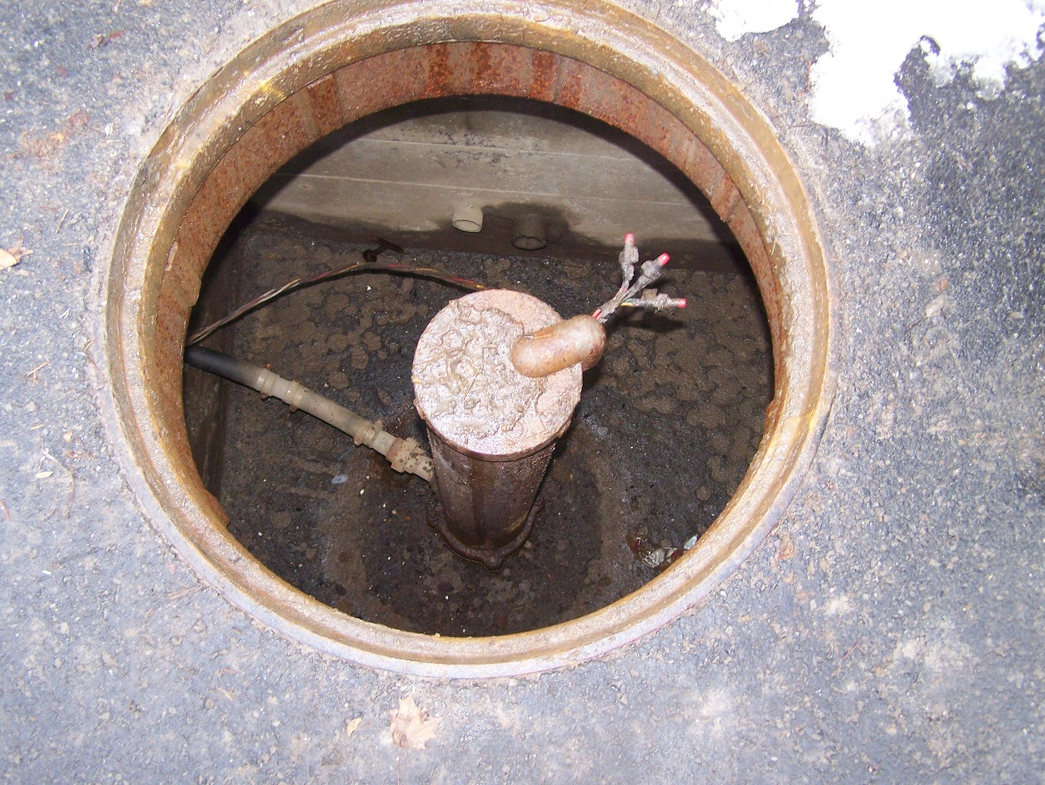
More well issues
Well in pit subject to flooding
Evidence of flooding
Not proper cap
Notes:
Additional story – operator left well cap off, mouse crawled down died, total coliform hits, lost disinfection waiver

Slide 50
Level 2 Assessment Questions
Source – Spring
  Condition of the spring?
  Secured to prevent unauthorized access?

Slide 51
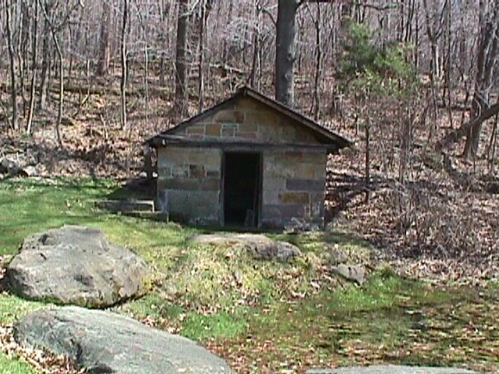
What’s the problem?
Notes:
No door – anyone can access and vandalize

Slide 52
Level 2 Assessment Questions
Source – Surface Water Supply
  Sewer spills, source water spills, or other disturbances?
  Algal blooms?
  Source water turnover occurred?

Slide 53
Potential Source of Contamination?
Notes:
Manure on Owasco Lake in winter – may not directly lead to TC + samples but may cause operational changes due to lower source water quality

Slide 54
Level 2 Assessment Questions
Environmental Events
  Heavy rainfall/rapid snowmelt/flooding?
  Changes in available source water? (significant drop in water table, well levels, well capacity, etc.)
  Interruptions to electrical power?
  Extremes in hot or cold?
Notes:
Electrical power interruptions shouldn’t be an issue for larger systems because they should all have backup power generators (few counties require all community water systems to have backup power)

Slide 55
Additional information on Assessments from EPA
Revised Total Coliform Rule Assessments and Corrective Actions Guidance Manual (Interim Final, 164 pages) - http://water.epa.gov/lawsregs/rulesregs/sdwa/tcr/upload/epa815r14006.pdf

Slide 56
Sample Siting Plans

Slide 57
Sample Siting Plan
Current TCR | Revised TCR
Systems must collect samples that are representative of water throughout the distribution system according to a written sample siting plan Plans are subject to State review and revision | Systems must develop a written sample siting plan that identifies sampling sites and a sample collection schedule that are representative of water throughout the distribution system, no later than March 31, 2016 Sites may include a customer’s premise, dedicated sampling station or other designated compliance sampling station Routine, repeat and Ground Water Rule sampling sites must be reflected in the plan Plans are subject to State review and revision

Slide 58
Sample Siting Plan
Systems must develop a written sample siting plan that identifies sampling sites and a sample collection schedule that are representative of water throughout the distribution system
Sites may include; customer’s premise, dedicated sampling station, other designated compliance sampling station
Routine, repeat, GWR sampling sites must be reflected in plan

Slide 59
Sample Siting Plan
Subject to State review and revision
Transition to revised rule on current plan
State is working on a Total Coliform Sample Siting Plan template for water systems to use
Sampling plan to be evaluated during sanitary surveys to determine if plan is appropriate

Slide 60
Thank You - Questions
Kevin J. Kenyon
Public Health Engineer II
New York State Department of Health
Bureau of Water Supply Protection
Empire State Plaza – Corning Tower Room 1119
Albany, NY 12237
(518) 402-7682; Fax: (518) 402-7599
kevin.kenyon@health.ny.gov

